Slide 1
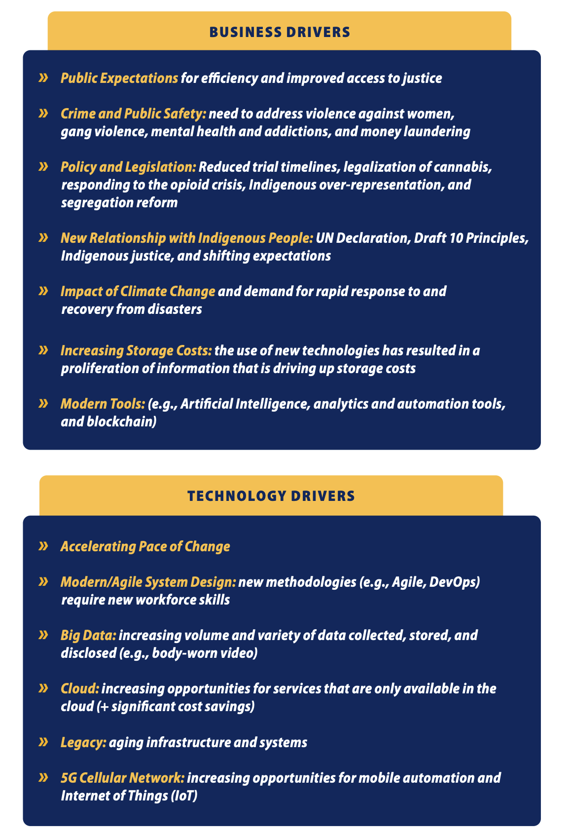
The Digital Imperative
Justice and Public Safety Sector Digital Strategy
The Justice and Public Safety Sector Digital Strategy aims to integrate data and technology capabilities to improve outcomes for British Columbians. The strategy focuses on three core areas:
fostering a culture of innovation,
establishing digital governance and processes,
developing digital capabilities and platforms.
The strategy aims to create seamless, smart, and continuously improved digital justice and public safety services that are accessible anytime, anywhere and on any device. The strategy addresses the challenges faced by the justice and public safety sector.

Slide 2
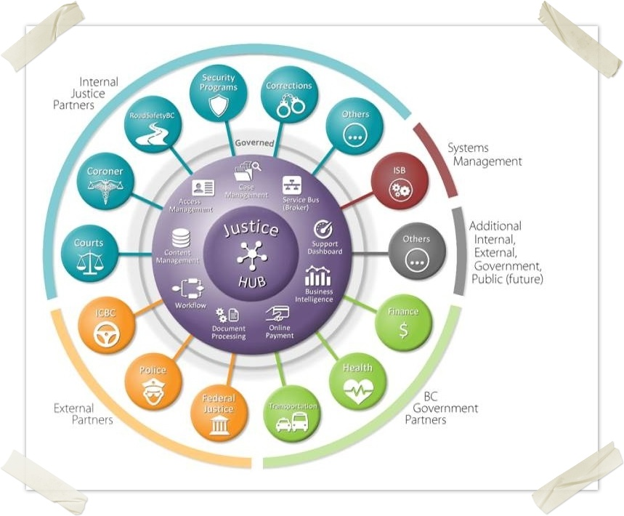
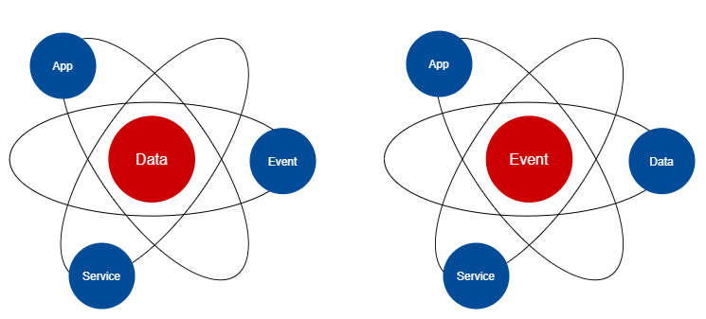
Scaling Vision – The Digital Business Nervous System
Concept: ISL – Enterprise Agile-Integrated Digital Ecosystem.
Integration Services Layer (ISL) as event-based business integration platform for an enterprise.
Being event-driven is different for the sector:
Instead of focusing on data at rest, we focus on data in flight.
Instead of preserving data as the first priority, we focus on responding to events as the first priority.
Instead of data stores being the source of truth, we rely on the log of events as the source of truth.
Instead of IT as enterprise information repository, we see IT as the sector's digital business nervous system.
ISL

Slide 3
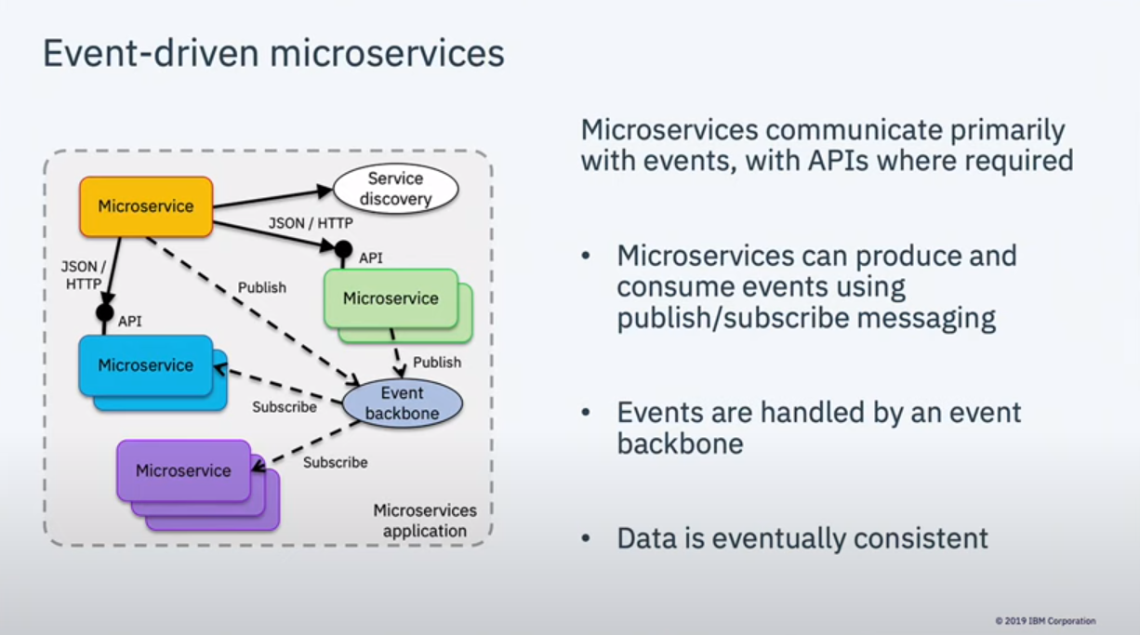
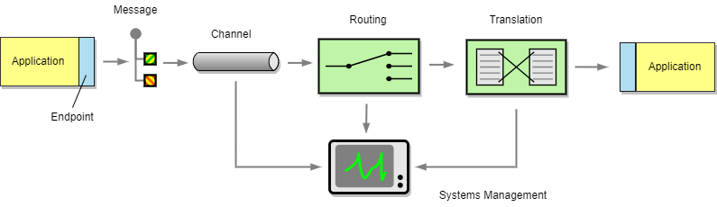
ISL Building Blocks
ISL is an ecosystem of business domain-specific integration services built on Enterprise Integration Patterns. An ISL integration service is composed of one or more of:
Event Topic – a time-based collection of business events related to specific business objects (e.g., a court case).
Adapter – a two-way smart system interface designed to connect an external system to a specific business domain in ISL.
Service – a business level API (aka “commands”) that decouples a business function from the underlying system or systems that implement it.
Processor – an independent event processing logic that can be developed and deployed independently. (learned improvement from current DEMS Integration work.)
In addition, ISL integration services are monitored and reported using Splunk.

